Slide 1


Quanto Credit Default Swaps
Theory, Pricing & Practice
Nicholas Burgess

Slide 2
PART ONE: Theory
Quanto CDS
Introduction to Quanto CDS
CDS Pricing & Par Spread
Quanto FX Risks
Quanto Hazard Rates
Quanto Basis Spread
PART TWO: Pricing & Practice
Case Studies
FX Crash & Covariance Impact
Quanto Par Spreads
Quanto Basis
Corporate Quanto Basis
Brazil Quanto CDS ‘What-If’ Analysis
Quant Research Papers
www.link-to-cds-research.com
Support Materials: Excel & Python Examples
www.link-to-excel-and-python-examples.com

Slide 3
PART ONE - THEORY
Quanto CDS

Slide 4

Quanto CDS – Description
Credit Default Swap
An insurance contract to protect against losses should the reference bond default
The protection buyer pays regular Fixed Premiums in exchange for the Loss Given Default, LGD = N( 1 – RR)
Liquid vs Contractual Currency
The Liquid Currency for a CDS contract is USD, regardless of bond domicile & issue currency
When the CDS Contractual Currency is not the liquid currency, the CDS is considered a Quanto CDS

Slide 5
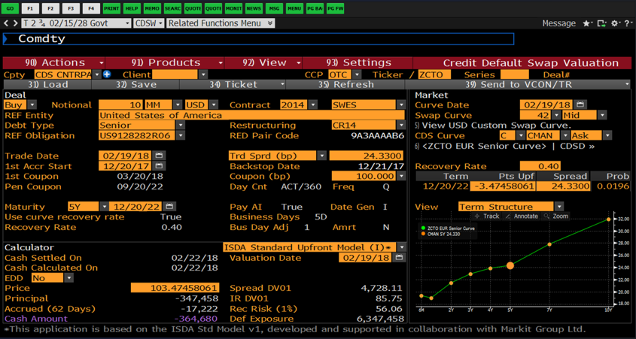
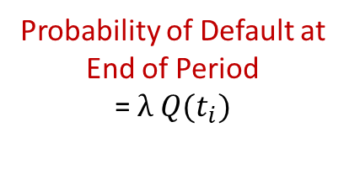
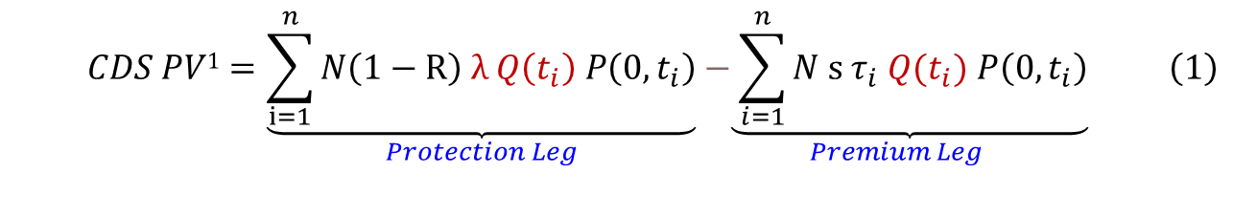
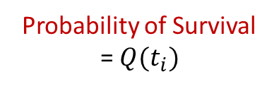
Credit Default Swaps – Pricing
Probability of Default at End of Period
= $λ Q(t_{i})$
Probability of Survival
= $Q(t_{i})$
Present Value is the sum of Risky Discounted cash flows
$$\begin{aligned} CDS PV1=\underset{Protection Leg}{\underbrace{\sum_{i=1}^{n}{N\left(1−R\right) λ Q\left(t_{i}\right) P\left(0,t_{i}\right)}}}\underset{Premium Leg}{−\underbrace{ \sum_{i=1}^{n}{N s τ_{i} Q(t_{i}) P\left(0,t_{i}\right)}}} \#\left(1\right)\end{aligned}$$

Slide 6
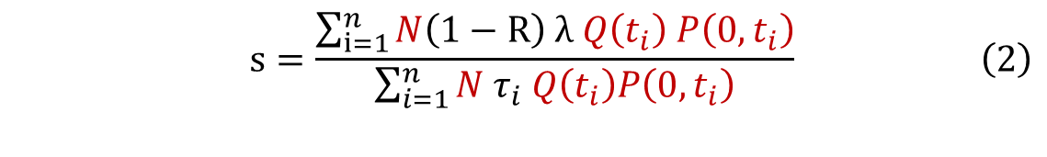

Credit Default Swaps – Par Spread
Quotation
CDS contracts typically quote as a Par Spread, s
This is the spread that makes the premium and protection leg PVs equal.
Par Spread Formula
Setting the PV in equation (1) to zero and rearranging gives (2),
$$\begin{aligned}s=\frac{\sum_{i=1}^{n}{N\left(1−R\right) λ Q\left(t_{i}\right) P\left(0,t_{i}\right)}}{\sum_{i=1}^{n}{N τ_{i} Q\left(t_{i}\right)P\left(0,t_{i}\right)}}\#\#\left(2\right)\end{aligned}$$
Par Spread Rule of Thumb
Terms in red cancel and assuming annual premiums i.e., $τ=1$ gives a simple rule of thumb,
$$\begin{aligned}s≈\left(1−R\right) λ\#\#\#(3)\#\end{aligned}$$

Slide 7
Quanto CDS – FX Risks
Quanto Risk
Consider CDS trading in USD (Liquid) and BRL (Quanto)
Typically, the BRL Quanto CDS will be illiquid, so we might use USD Hazard Rates as proxy
When using USD Hazard Rates to price Quanto CDS we need to adjust for Quanto FX risk
Quanto FX Risk = Crash Risk + Covariance Risk
FX Crash Risk
FX devaluation or crash risk on default
Quanto CDS Spreads cheapen relative to USD
FX Covariance Risk
FX covariance with credit spreads
As default intensity increases, Quanto currency weakens
Quanto protection becomes cheap relative to USD

Slide 8
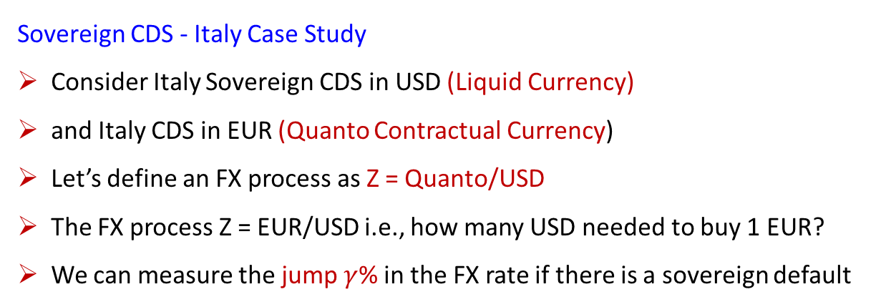
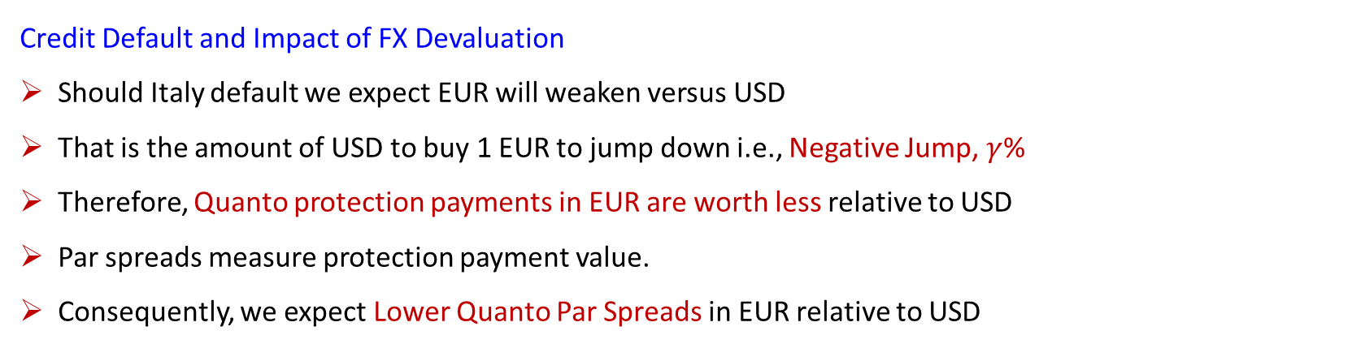
Credit Default Swaps – FX Jump on Default Explained
Sovereign CDS - Italy Case Study
Consider Italy Sovereign CDS in USD (Liquid Currency)
and Italy CDS in EUR (Quanto Contractual Currency)
Let’s define an FX process as Z = Quanto/USD
The FX process Z = EUR/USD i.e., how many USD needed to buy 1 EUR?
We can measure the jump $γ$% in the FX rate if there is a sovereign default
Key Points:
Negative FX Jump on Default
Quanto Protection Cheapens (Relative to USD)
Lower Quanto CDS Spreads
Credit Default and Impact of FX Devaluation
Should Italy default we expect EUR will weaken versus USD
That is the amount of USD to buy 1 EUR to jump down i.e., Negative Jump, $γ$%
Therefore, Quanto protection payments in EUR are worth less relative to USD
Par spreads measure protection payment value.
Consequently, we expect Lower Quanto Par Spreads in EUR relative to USD

Slide 9
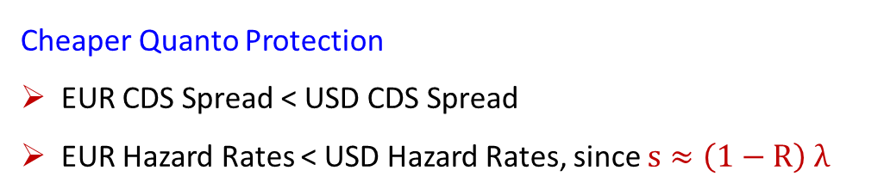
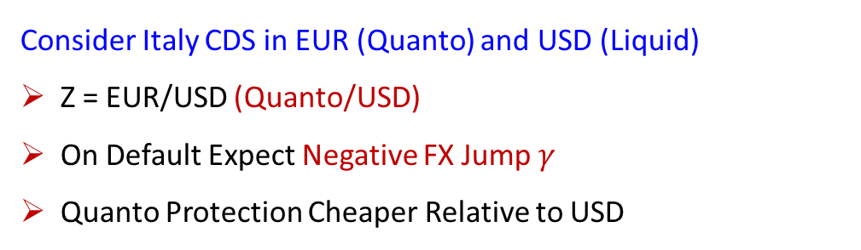
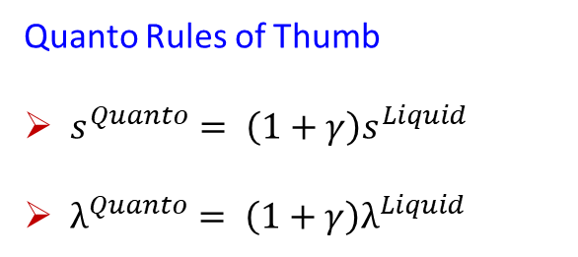
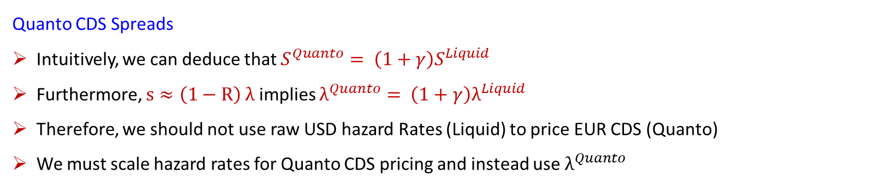
Credit Default Swaps – Price Impact of FX Jump on Default
Consider Italy CDS in EUR (Quanto) and USD (Liquid)
Z = EUR/USD (Quanto/USD)
On Default Expect Negative FX Jump $γ$
Quanto Protection Cheaper Relative to USD
Quanto Rules of Thumb
$s^{Quanto}= \left(1+γ\right)s^{Liquid}$
$λ^{Quanto}= \left(1+γ\right)λ^{Liquid}$
Cheaper Quanto Protection
EUR CDS Spread < USD CDS Spread
EUR Hazard Rates < USD Hazard Rates, since $s≈\left(1−R\right) λ$
Quanto CDS Spreads
Intuitively, we can deduce that $S^{Quanto}= \left(1+γ\right)S^{Liquid}$
Furthermore, $s≈\left(1−R\right) λ$ implies $λ^{Quanto}= \left(1+γ\right)λ^{Liquid}$
Therefore, we should not use raw USD hazard Rates (Liquid) to price EUR CDS (Quanto)
We must scale hazard rates for Quanto CDS pricing and instead use $λ^{Quanto}$

Slide 10
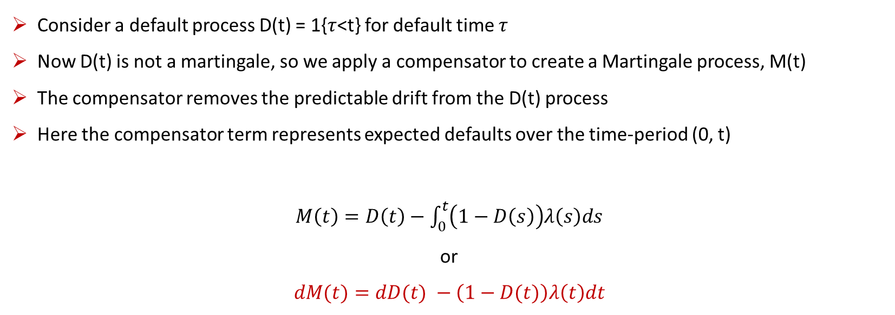
Credit Default Swaps – Mathematics of Quanto Hazard Rates I
Consider a default process D(t) = 1{$τ$<t} for default time $τ$
Now D(t) is not a martingale, so we apply a compensator to create a Martingale process, M(t)
The compensator removes the predictable drift from the D(t) process
Here the compensator term represents expected defaults over the time-period (0, t)
$M\left(t\right)=D\left(t\right)−$ $\int_{0}^{t}{\left(1−D\left(s\right)\right)λ\left(s\right)ds}$
or
$$dM(t)=dD(t) −\left(1−D(t)\right)λ\left(t\right)dt$$

Slide 11
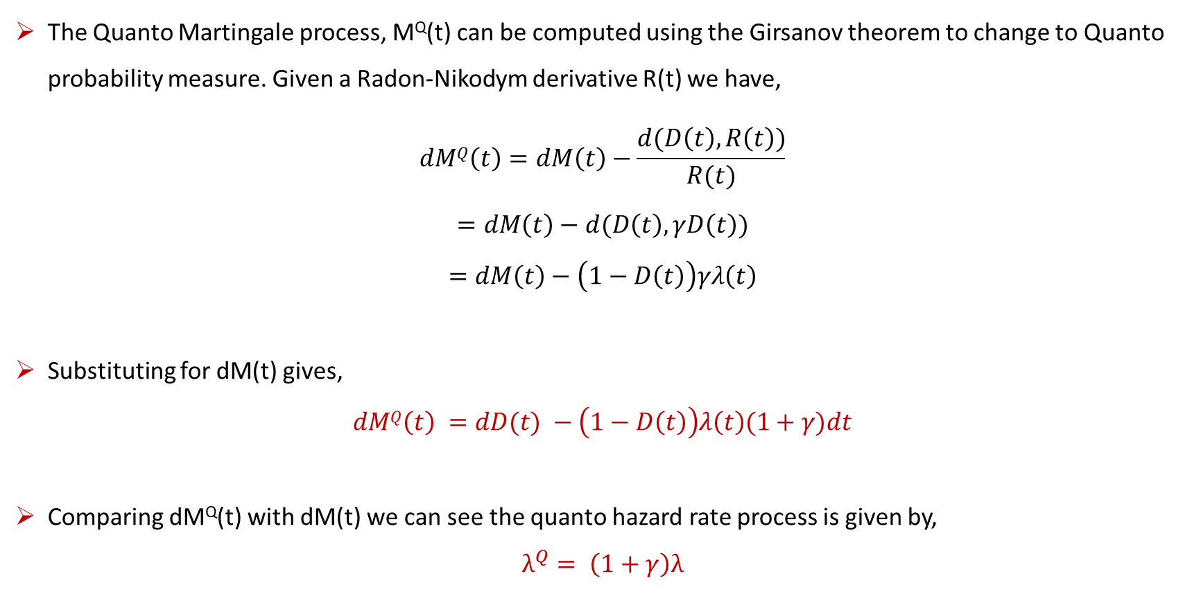
Credit Default Swaps – Mathematics of Quanto Hazard Rates II
The Quanto Martingale process, M^{Q}(t) can be computed using the Girsanov theorem to change to Quanto probability measure. Given a Radon-Nikodym derivative R(t) we have,
$$dMQ\left(t\right)=dM\left(t\right)−\frac{d(D\left(t\right),R\left(t\right))}{R(t)}$$
$$=dM\left(t\right)−d(D\left(t\right),γD\left(t\right)) \\ =dM\left(t\right)−\left(1−D\left(t\right)\right)γλ\left(t\right)$$
Substituting for dM(t) gives,
$$dMQ\left(t\right) =dD(t) −\left(1−D\left(t\right)\right)λ\left(t\right)(1+γ)dt$$
Comparing dM^{Q}(t) with dM(t) we can see the quanto hazard rate process is given by,
$$λ^{Q}= \left(1+γ\right)λ$$

Slide 12
PART TWO – PRICING & PRACTICE
Case Studies
Quanto Credit Default Swaps

Slide 13
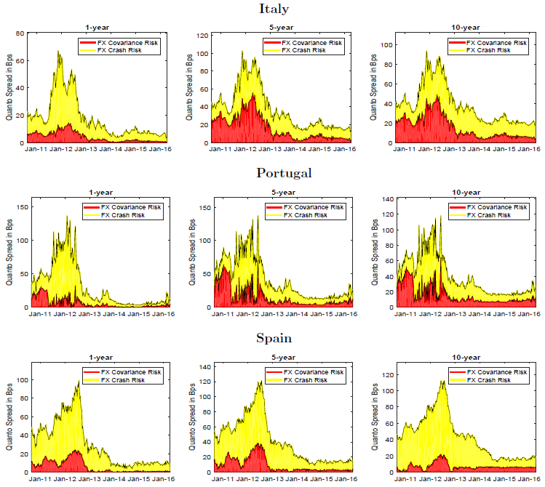
Case Study – FX Crash & Covariance Effect on Spreads
Eurozone FX Crash Risk
Varies depending on credit regime & market distress
On average accounts for ca. 10 bps of Quanto Basis
Eurozone FX Covariance
Similar to FX crash risk, covariance risk of ca. 10 bps
Covariance risk grows with CDS maturity
Source: Lando & Nielson (2018)

Slide 14
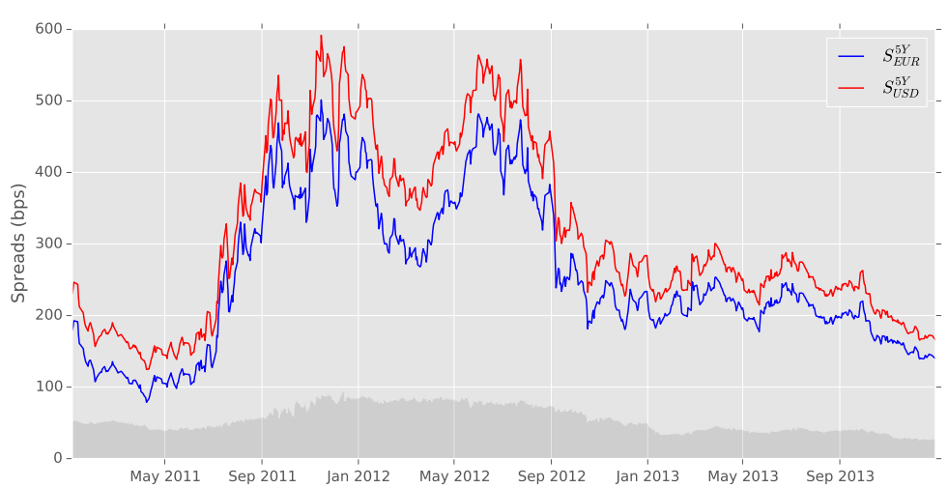
Credit Default Swaps – Quanto Par Spreads
Quanto Par Spreads
Typically, Quanto CDS spreads are lower than the liquid currency CDS in USD
Italy CDS Spreads: EUR vs USD
Italy CDS spreads in EUR (Quanto) are lower than those in USD by ca. 20 bps
Italy CDS Spreads, Source: Brigo (2016) – Quant Summit Europe

Slide 15
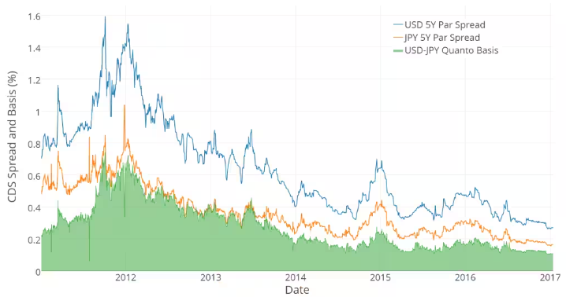

Credit Default Swaps – Sovereign Quanto Basis
Quanto Basis
The difference between USD and Quanto CDS Spreads is called the Quanto Basis
$$s^{JPY}= \left(1+γ\right)s^{USD}$$
Japan Sovereign CDS Spreads
Japan CDS spreads in JPY (Quanto) are lower than those in USD by ca. 20 bps
Japan Sovereign CDS Spreads, Source: S&P Global (2018)

Slide 16
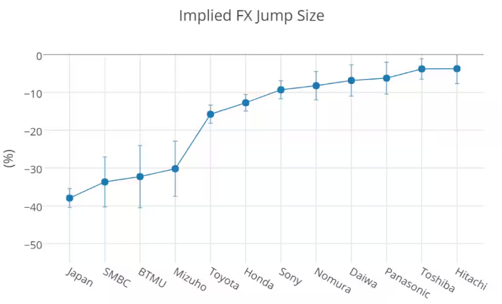
Credit Default Swaps – Corporate Quanto Basis
How to Imply FX Quanto Basis for Corporates?
In Japan corporate CDS market, significant negative FX Jumps (JPY Devaluation) priced in.
FX jump sizes are strongly correlated with systemic importance of corporate
There is evidence of similar FX jump sizes across industry groups. Suggests possibility of building sector basis curves
Japan Corporate Implied FX Jump Sizes, Source: S&P Global (2018)

Slide 17
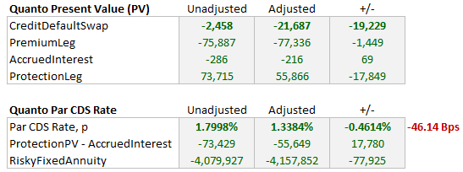
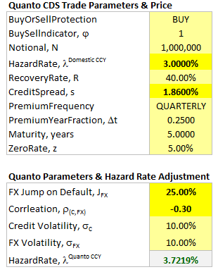
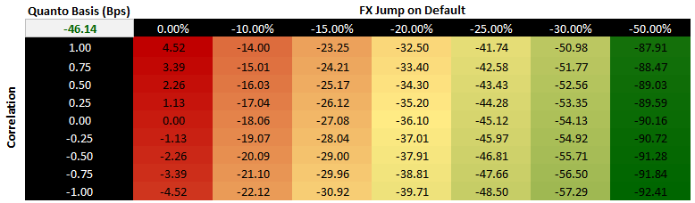
Credit Default Swaps – BRL Quanto CDS
Brazil Sovereign CDS Spreads (BRL)
Consider an FX jump of -25%
CDS spreads in BRL (Quanto) would be lower than those in USD by ca. 46 Bps
What-If Analysis

Slide 18
Contact
Have questions or want further info?
LinkedIn: www.linkedin.com/in/nburgessx

